Slide 1
One line, one world.
SMART

Slide 2

Zenobia Ship
Ship-shaped painting robot
IR and Bluetooth control
Based on Arduino
Multi-directional Products
For gift
For fun
For exploration

Slide 3
Drawing operations
A beautiful decoration
A steamship in industrial era
About appearance design

Slide 4
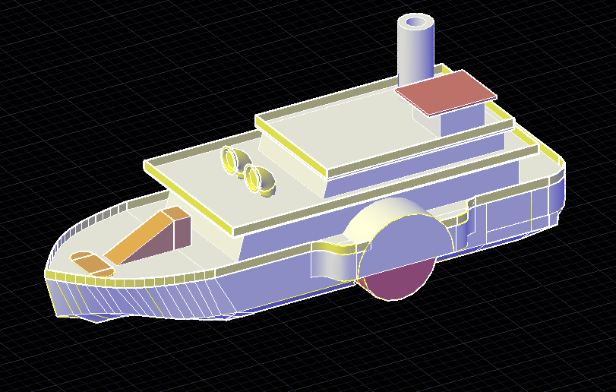
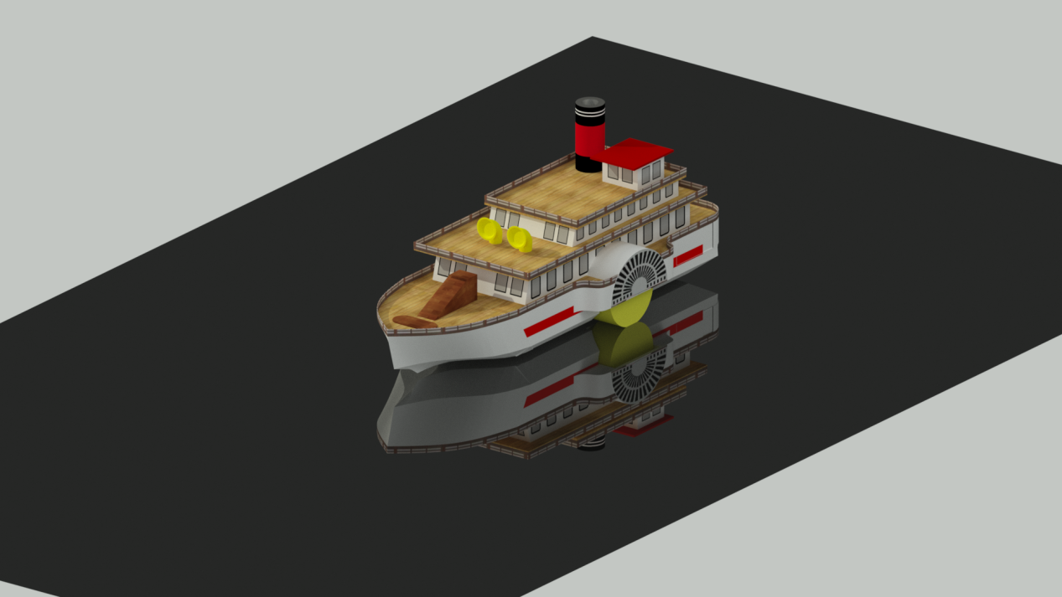
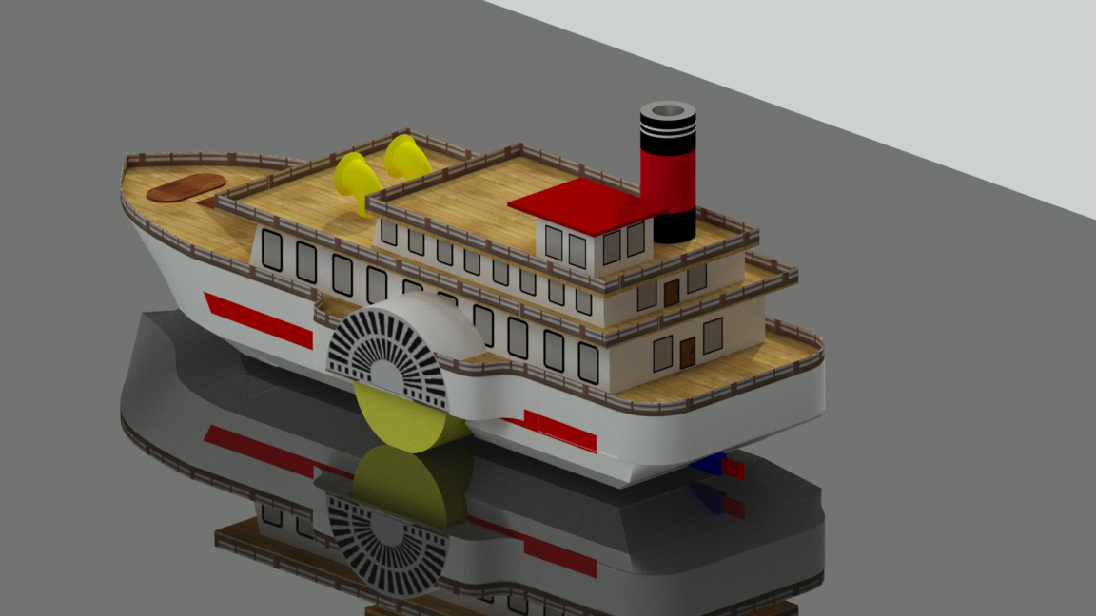
CAD Modeling
concept
after render

Slide 5
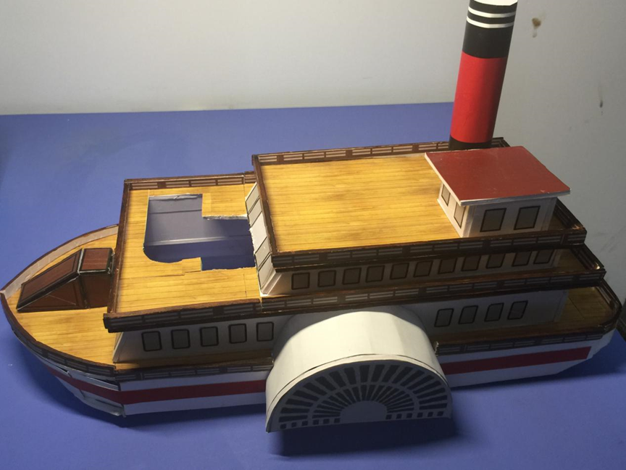
The electric indicator light in the captain's room
Set the horn in the whistle position
Closer to reality
Reflect the romantic feeling of steam punk in the industrial age.

Slide 6
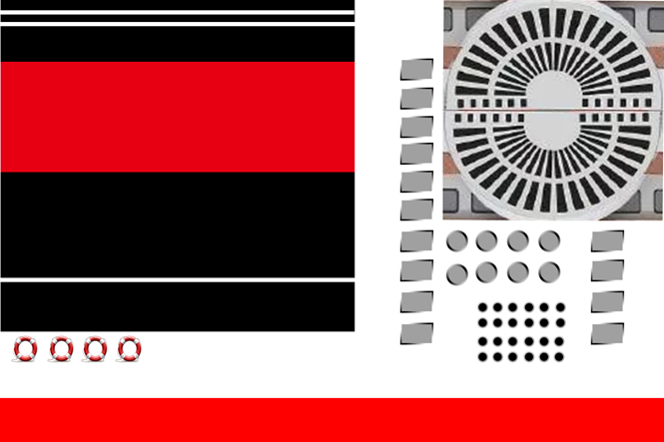
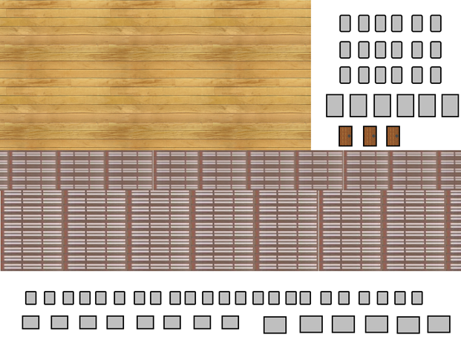
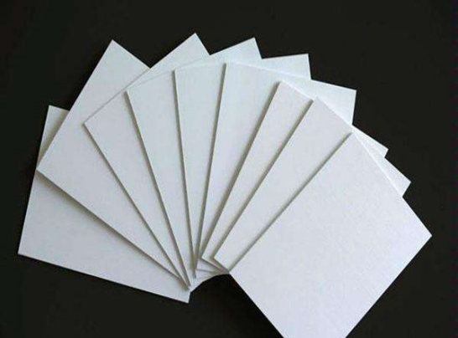
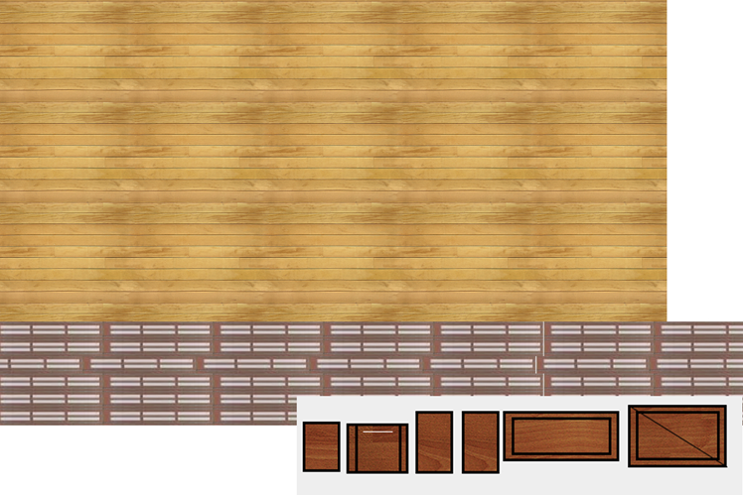
Pattern →
← Chevron board

Slide 7
Zenobia functions
Drawing graphics
IR remote control mode
Bluetooth mode
Ultrasonic obstacle avoidance
Play music
About functional design

Slide 8
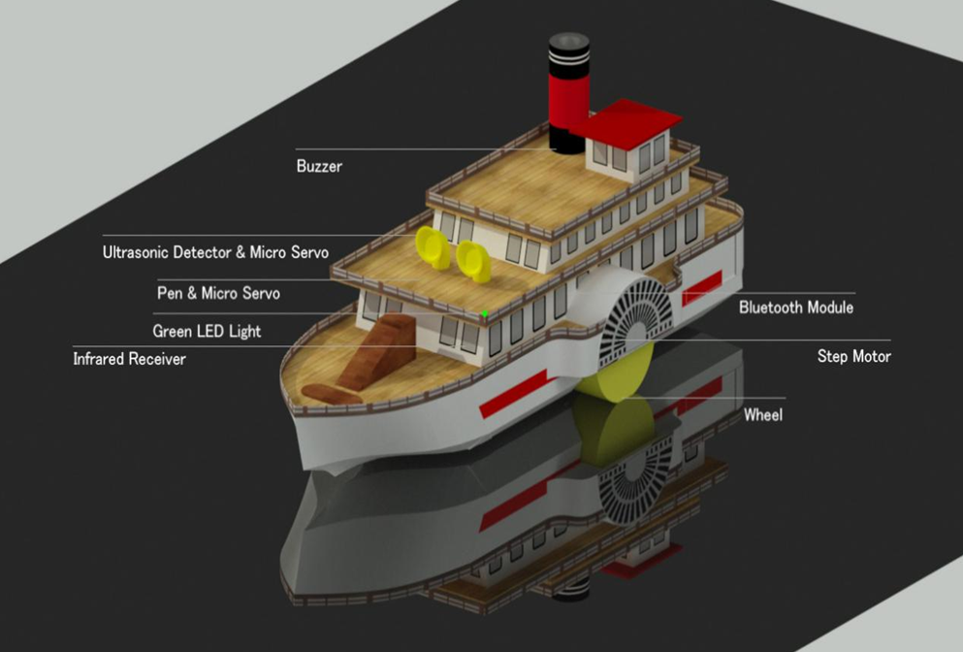
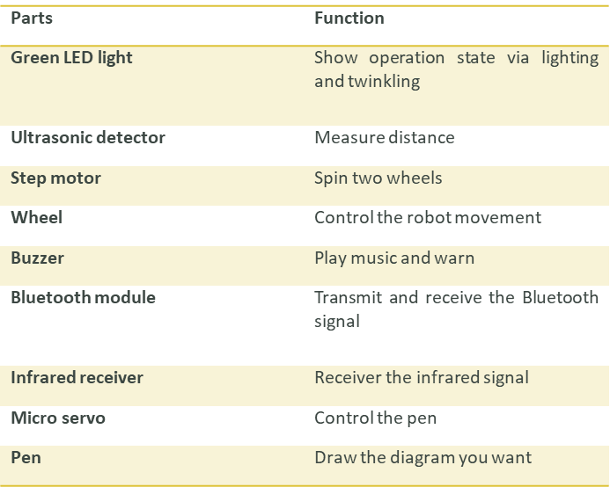
Description of parts

Slide 9
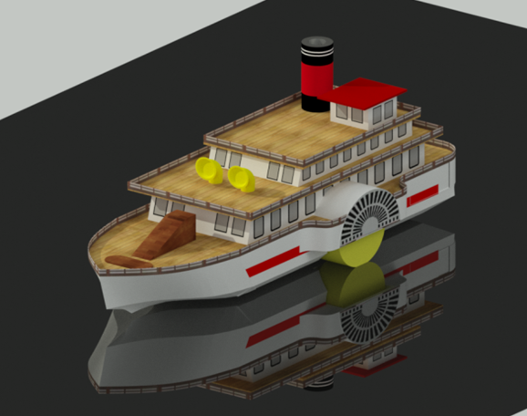
About functionality
Infrared devices
Bluetooth device
Drawing and walk
Ultrasonic obstacle avoidance
LED light
Buzzer

Slide 10
What’s new?
User custom drawing.
Support Bluetooth mode.
Realize ultrasonic obstacle avoidance.
Play music.
The technical innovation of drawing robot

Slide 11
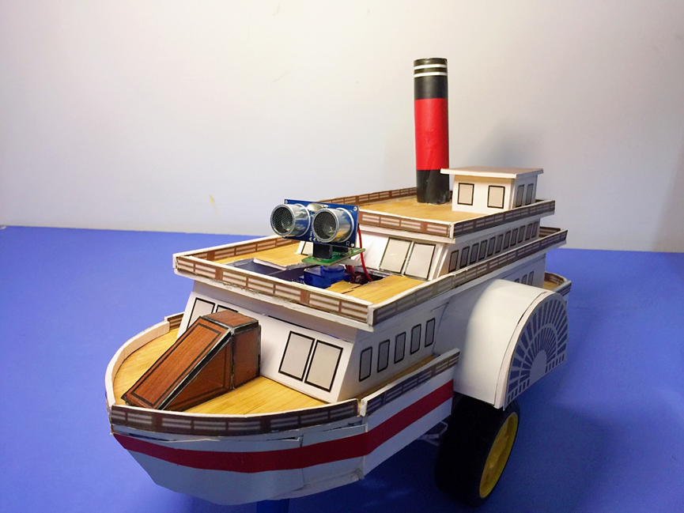
Cost?
Nationwide Warranty
After-sales service
Support trade-in
15￡

Slide 12
Thanks
SMART

